Slide 1
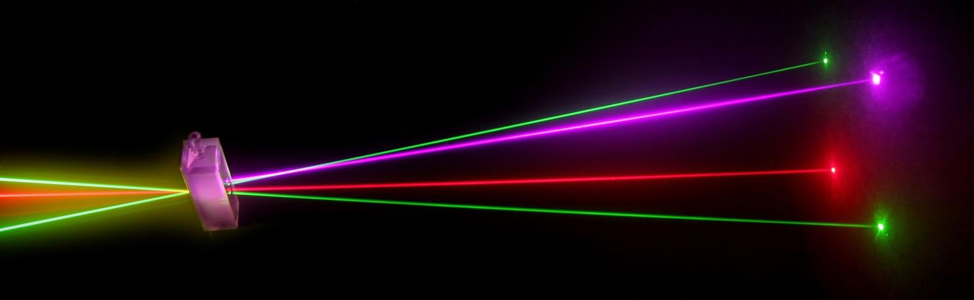
“Laser Technology and Applications” 16B1NPH533 Lecture 33-35
Types of Lasers:
Ruby Laser
Nd: YAG Laser
Alexandrite laser,
Titanium-Sapphire laser
Fiber laser

Slide 2
TYPES OF LASERS
Several ways to classify lasers
Mode of operation :
Continuous Wave (CW) or Pulsed
▪ Active medium:
- Solid lasers
- Gas lasers
- Liquid lasers
Semiconductor lasers
On basis of other parameters
▪ Gain of the laser medium
▪ Power delivered by laser
▪ Efficiency or
▪ Applications

Slide 3
SOLID STATE LASER: BASICS
Active centers are fixed /doped (~ 1%) in a dielectric crystal or glassy material
Electrically non-conducting
⇒ also called Doped-insulator lasers.
• Crystal atoms act as host lattice to active centers
• Crystal usually shaped as rod
• Pumping: Flash lamp or diode laser
• Active centers are from the rare earth, transition metals, or actinides
• Water cooled

Slide 4
SOLID STATE LASER: REQUIREMENTS
❑ Requirements for Host material :
• Should not absorb light at laser wavelength
• Must possess sharp fluorescent lines, strong absorption bands, and high quantum efficiency
• Crystal should have good thermal conductivity
❑ Problems with Host material :
o Most of excitation energy ends up as heat rather than light o Excess heat damages the laser crystal
▪ Active centres are ions from:
Chromium (Cr), Neodymium (Nd), Titanium (Ti), Cerium (Ce), Erbium (Er), Holmium (Ho) and Cobalt (Co)
❖ Chromium is active centre in Ruby and Alexandrite lasers ❖ Neodymium is active centre in commonly used Nd: YAG laser

Slide 5
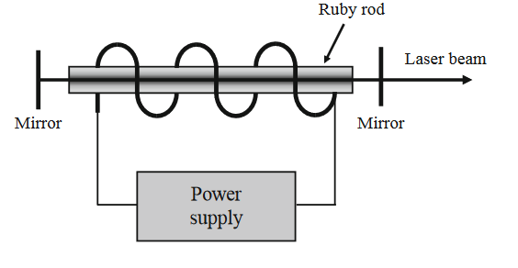
RUBY LASER: THE FIRST LASER
▪ First Laser developed in 1960 (TH Maiman)
Ruby laser rod:
▪ A synthetic pink Ruby crystal (Al₂O₃ doped with Cr³⁺ ions)
▪ Cr³⁺ions concentration: 0.05%, ⇒Approx 1.6×10²⁵ ions per cubic meter.
• Active Centres (Cr³⁺ions) have a set of three energy
• Aluminum & Oxygen ions are inert
• Ruby crystal as cylindrical rod (4cm length 0.5 cm in diameter)
• Helical photographic flash lamp filled with Xenon.
The Al₂O₃(sapphire) host is hard, with high thermal conductivity, and transition metals can readily be incorporated substitutionally for the Al

Slide 6
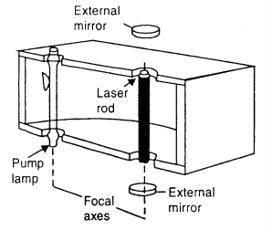
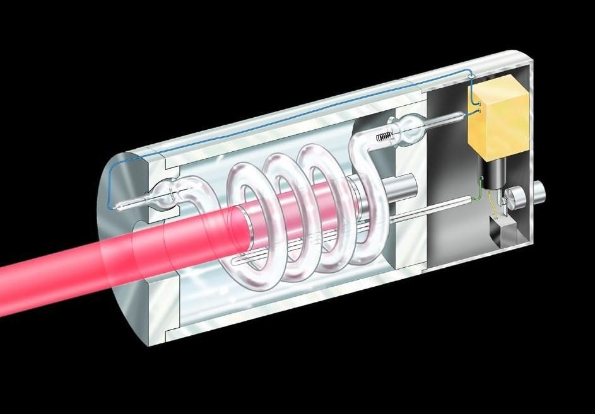
RUBY LASER: COMMERCIAL
▪ End faces grounded and polished
▪ Mostly silvered faces (100% & 90 % reflection) Febry-Perot Resonator
• System is cooled with the help of a
coolant circulating around the ruby rod
▪ In practical lasers flash lamps of helical
design no longer used
▪ Most commonly used are linear lamps

Slide 7
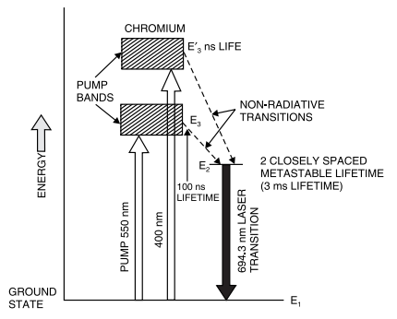
RUBY LASER : WORKING PRINCIPLE
▪ A Three level laser system
▪ E₂- metastable state (3ms)
• Ruby rod pumped with an intense Xenon flash lamp
• Ground state of Cr³⁺ ions absorb light at pump bands
⮚550nm and 400nm
• Non-radiative transitions to E₂
• Population Inversion at E₂
Energy levels of chromium ions is Ruby laser
❖ Radiative transitions from E₂to E₁ ⇒ Red wavelength at 694.3 nm ❖Under intense excitation: Pumping > Critical threshold ❖A spontaneous fluorescent photon (red) acts as input and trigger
⇒ Stimulated emission; SYSTEM LASES

Slide 8
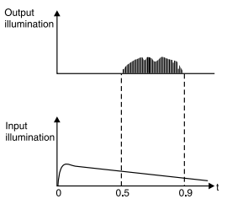
RUBY LASER: OUTPUT
Laser Output: Pulsed with low repetition rate (1 to 2 per sec)
• Stimulated transitions faster than rate at which population inversion is maintained
• Once stimulated emission commence, the metastable state E₂, depopulate very rapidly
• At the end of each pulse, population at E₂falls below the threshold value required for sustaining emission of light
• Lasing ceases & Laser becomes inactive
• Series of irregular spikes stretching over the duration of pump pulse
• Q-switching concentrates output into a single pulse
Next pulse will arrive only after P.I. is restored
❖ High energy storage capability due to long upper laser level lifetime
❖ Pulse energy upto 100J
❖ Relatively inefficient; ≈ 0.1 to 1%
Variety of applications: Plasma diagnostics; Holography.

Slide 9
Nd: YAG LASER
• Yttrium Aluminum Garnet (YAG) Y₃Al₅O₁₂ best choice of a host for neodymium ions (Nd) and other ions
• YAG offers low threshold and high gain
• YAG is a very hard, isotropic crystal
• good thermal and mechanical properties
• can be grown and fabricated in rods of high optical quality
• Operation: CW and pulsed mode (high repetition rate)
• Efficiency about 10 times as compared to ruby
• Drastic weight reduction
• Replaced ruby in military Rangefinders, other applications
• Used in the semiconductor industry for resistor trimming, silicon scribing, and marking
For continuous or very high repetition-rate operation, crystalline materials provide higher gain and greater thermal conductivity

Slide 10
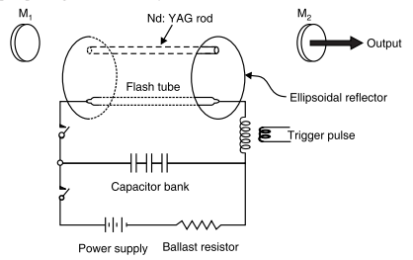
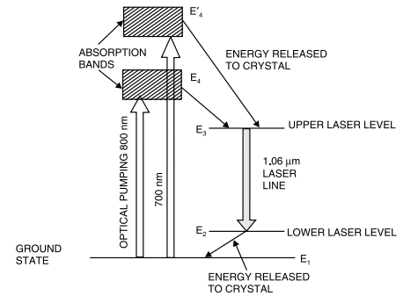
Nd: YAG LASER
▪ A Four level laser system: Require lower pump energy
• Terminal laser level sufficiently far from ground state
• E₃ – metastable level (lifetime 230 μs)
• Two pump bands: 700 nm & 800nm
• Pump: intense Xenon flash lamp
• Nd³⁺ ions level E_{4,} decays to upper laser level at E₃
• Population inversion easily achieved between E₃and E₂levels.
• Stimulated to emit 1064 nm laser transition.
From E₂level, Nd³⁺ ions quickly drop to E₁ by transferring energy to crystal

Slide 11
Nd: YAG LASER
▪ Many other transitions in near IR region; all weaker than 1064 nm
• Only 1318 nm transition produces 20% power as that of 1064 nm
Laser Output:
• In the form of pulses of variable high repetition rate
• Xenon flash lamps : Pulsed output
• Tungsten halide incandescent lamps : CW output
⮚CW output power of over 1 kW obtainable.
❖Can be pumped by a diode laser (GaAs) for high efficiency
2nd harmonic generation results in half the wavelength (532 nm)

Slide 12
Nd: GLASS LASER
• Glasses are more suitable for high-energy pulsed operation because of their large size, flexibility in their physical parameters, and the broadened fluorescent line
• Can deliver much higher energies
• Can be doped at very high concentrations with excellent uniformity
• Practical doping limit is determined by the fact that the fluorescence lifetime and therefore the efficiency of stimulated emission, decreases with higher concentrations
• Can be made in a variety of shapes and sizes, from fibers of few micrometers in diameter to rods 2m long and 7.5 cm in diameter and disks up to 90 cm in diameter and 5 cm thick.
The major disadvantage of glass is a low thermal conductivity

Slide 13
Nd: GLASS LASER
❑Glass: An excellent host material for Nd
Attraction for Glass: well developed technology for making large size glass (laser) with good optical quality
❖ While Nd: YAG laser can be operated in CW mode; Nd: glass laser only operate in pulsed mode because of low thermal conductivity of glass
❖ Nd:glass laser ⇒very high output energy per unit volume of material
• High energy in short pulses can heat matter to thermonuclear temperatures, thus generating energy in small controlled explosions (inertial fusion)
• NOVA lasers developed for Nuclear Fusion by Lawrence Livermore National Lab. (USA) – employed a large number of Nd: glass amplifiers to produce 100 kJ of energy in a 2.5 ns pulse

Slide 14
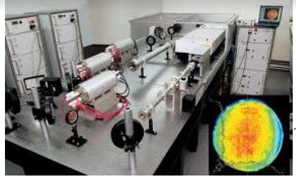
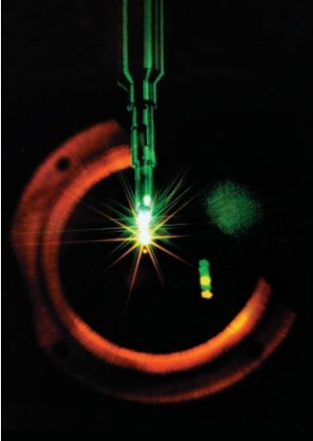
Nd: GLASS LASER
An inertial confinement fusion implosion on the NOVA laser creates "microsun" conditions of tremendously high density and temperature rivaling even those found at the core of our Sun.

Slide 15
Tunable Solid State Lasers: Ti: Sapphire Laser
Alexandrite (BeAl₂O₄ : Cr³⁺) is the common name for chromium-doped chrysoberyl
Tunability is due to band of vibrational levels which are a result of strong coupling between Cr³⁺ ion and the lattice vibrations
Doping ~ about 0.1% (density~3×10²⁵ ions /m³); Rod shaped ; 10cm long, 6mm in diameter
Pump levels at 380 nm & 630 nm; flash lamp pumped
Cr³⁺ levels in Alexandrite form upper and lower vibronic bands
Electronic levels of Cr³⁺ and vibrational levels of crystal lattice
Vibronic transitions can occur over a range of energies; excited ion can drop from upper level to anywhere in lower vibronic band – Gain Bandwidth
Tunable to any desired wavelength within its emission spectrum.
Can operates in a pulsed or CW mode
Widely used in cancer therapy, kidney stone removal and pollution detection

Slide 16
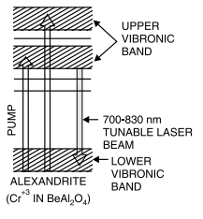
Tunable Solid State Lasers: Ti: Sapphire Laser
Titanium-Sapphire (Ti : Al₂O₃) laser is widely used tunable
Broad vibronic fluorescence band allows tunable laser output between 660–1180 nm, with the peak of the gain curve around 800 nm
Relatively large gain cross section (half of Nd :YAG at the peak of its tuning range)
The energy level structure of the Ti³⁺ ion is unique among transition- metal laser ions in that there are no d state energy levels above the upper laser level
Ti³⁺ ions replace some of Al3+ ions
Doping concentration ≈0.1% by weight
Operation: Pulsed or CW modes
630
nm
380
nm
Energy level diagram of chromium ions in alexandrite crystal (Absorption bands are very similar to those of ruby)

Slide 17
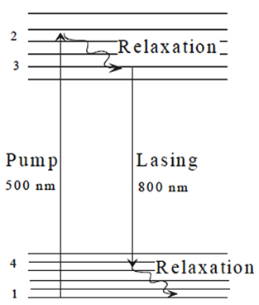
Tunable Solid State Lasers: Ti: Sapphire Laser
Life time of upper laser level is too short (only 3.8 μs), so can not be pumped with flash lamp. They are pumped with argon ion laser for CW operation or with frequency-doubled Nd: YAG laser for pulsed operation.
Energy level scheme
Most widely used in laser radar (LIDAR), range finders, remote sensing
and spectroscopy.

Slide 18
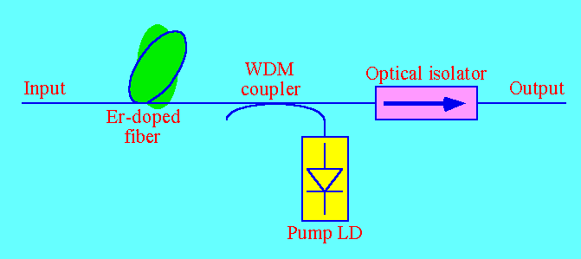
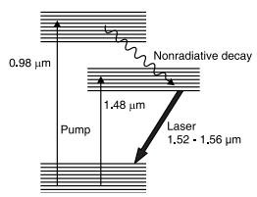
Fiber Lasers
Erbium in a glass host – forms a three level laser with wavelength centered around 1550nm (range: 1520-1560nm).
1550 nm is important operational window in OFC technology.
Needs lasers for pumping to get desired output.
Output transitions in the range from 1520-1560nm
EDFA is used as an optical amplifier in DWDM technology.
Highly useful in undersea and long haul OFC links.

